Slide 1
Singly Linked Lists

Slide 2
Linked list, provides an alternative to an array-based structure.
The traditional approach to implementing lists makes use of pointers and is called a linked list.
The linked list uses dynamic memory allocation (it allocates memory for new list elements as needed)
A linked list is made up of a series of objects, called the nodes of the list.
Because a list node is a distinct object ,it is good practice to make a separate list node class.
An additional benefit to creating a list node class is that it can be reused by the linked implementations for the stack and queue data structures.

Slide 3
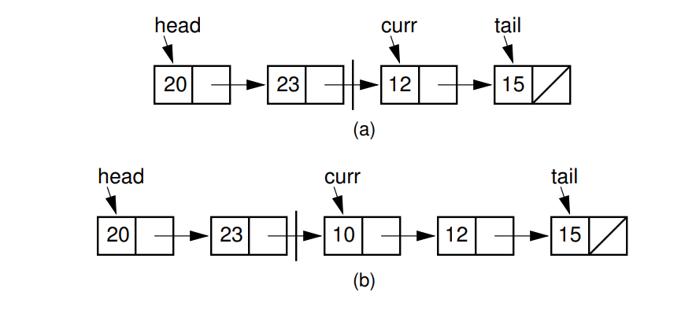
(a) Linked list prior to inserting element with value 10. (b) Desired effect of inserting element with value 10.

Slide 4
The value stored in a pointer variable is indicated by an arrow “pointing” to something.
Java uses the special symbol null for a pointer value that points nowhere, such as for the last list node’s next field.
A null pointer is indicated graphically by a diagonal slash through a pointer variable’s box.
The vertical line between the nodes indicates the current position.
The list’s first node is accessed from a pointer named head.

Slide 5
To speed access to the end of the list, and to allow the append method to be performed in constant time, a pointer named tail is also kept to the last link of the list.
The position of the current element is indicated by another pointer, named curr.
The value cnt stores the length of the list

Slide 6
Singly Linked List
A singly linked list is a concrete data structure consisting of a sequence of nodes, starting from a head pointer
Each node stores
element or data
link to the next node or reference
next
element
node
head
∅
A
B
C
D

Slide 7
A linked list, is a collection of nodes that collectively form a linear sequence.
In a singly linked list, each node stores a reference to an object that is an element of the sequence, as well as a reference to the next node of the list.
A linked list’s representation relies on the collaboration of many objects.
linked list instance must keep a reference to the first node of the list, known as the head.
Without an explicit reference to the head, there would be no way to locate that node (or indirectly, any others).
The last node of the list is known as the tail.

Slide 8
The tail of a list can be found by traversing the linked list— starting at the head and moving from one node to another by following each node’s next reference.
We can identify the tail as the node having null as its next reference. This process is also known as link hopping or pointer hopping.
However, storing an explicit reference to the tail node is a common efficiency to avoid such a traversal.
In similar regard, it is common for a linked list instance to keep a count of the total number of nodes that comprise the list (also known as the size of the list), to avoid traversing the list to count the nodes.

Slide 9
Inserting an Element at the Head of a Singly Linked List
An important property of a linked list is that it does not have a predetermined fixed size; it uses space proportional to its current number of elements.
When using a singly linked list, we can easily insert an element at the head of the list.
The main idea is that we create a new node, set its element to the new element, set its next link to refer to the current head, and set the list’s head to point to the new node.

Slide 10
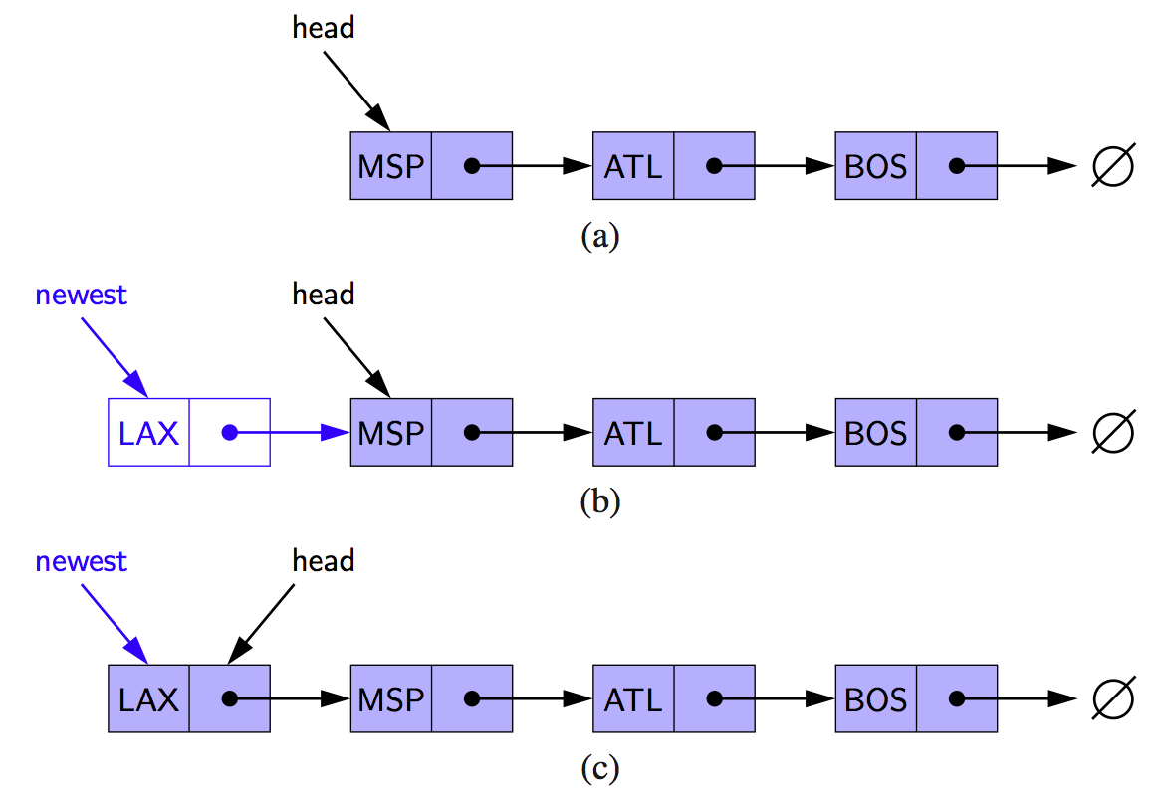
Inserting at the Head
Allocate new node
Insert new element
Have new node point to old head
Update head to point to new node
(a) before the insertion
(b) after a new node is created and linked to the existing head
(c) after reassignment of the head reference to the newest node.

Slide 11
Algorithm
addFirst(e):
newest = Node(e) {create new node instance storing reference to element e}
newest.next = head {set new node’s next to reference the old head node}
head = newest {set variable head to reference the new node}
size = size+1 {increment the node count}
Inserting a new element at the beginning of a singly linked list.
We set the next pointer of the new node before we reassign variable head to it.
If the list were initially empty (i.e., head is null), the new node has its next reference set to null.

Slide 12
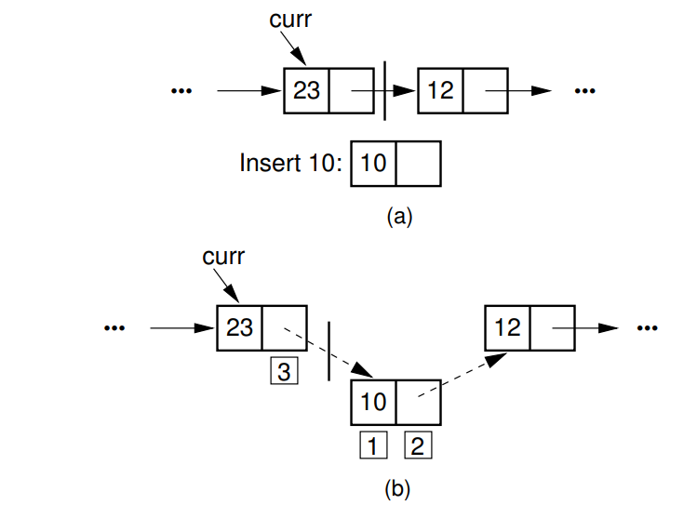
Linked List Insertion process

Slide 13
The linked list insertion process.
(a) The linked list before insertion.
(b) The linked list after insertion.
1 marks the element field of the new link node.
2 marks the next field of the new link node, which is set to point to what used to be the current node (the node with value 12).
3 marks the next field of the node preceding the current position. It used to point to the node containing 12; now it points to the new node containing 10.
Insert Method:
curr.setNext(new Link<E> (it, curr.next ()));

Slide 14
Inserting an Element at the Tail of a Singly Linked List
We can easily insert an element at the tail of the list, provided we keep a reference to the tail node.
Inserting an Element at the Tail of a Singly Linked List
we create a new node.
Assign its next reference to null.
Set the next reference of the tail to point to this new node.
Then update the tail reference itself to this new node.

Slide 15
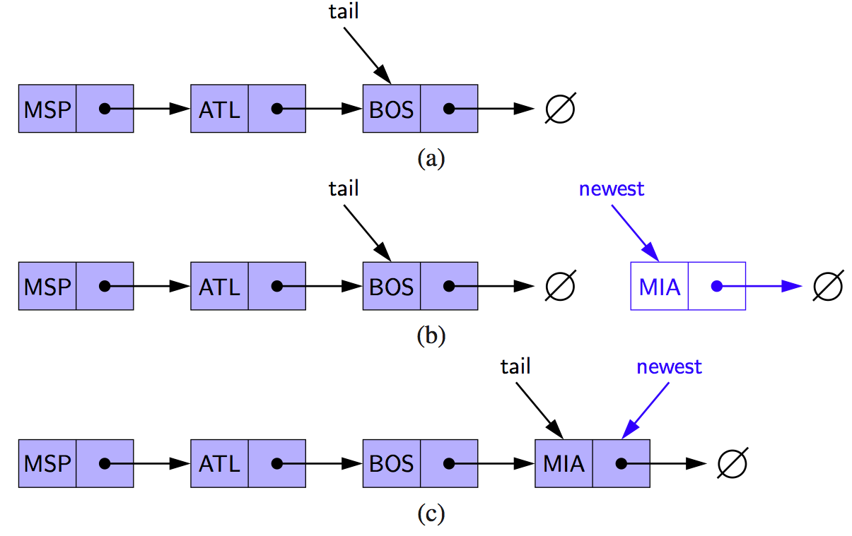
Inserting at the Tail
Allocate a new node
Insert new element
Have new node point to null
Have old last node point to new node
Update tail to point to new node
Insertion at the tail of a singly linked list: (a) before the insertion; (b) after creation of a new node; (c) after reassignment of the tail reference.
Note: we must set the next link of the tail node in (b) before we assign the tail variable to point to the new node in (c).

Slide 16
Algorithm
addLast(e):
newest = Node(e) {create new node instance storing reference to element e}
newest.next = null {set new node’s next to reference the null object} tail.next = newest {make old tail node point to new node}
tail = newest {set variable tail to reference the new node}
size = size+1 {increment the node count}
Inserting a new node at the end of a singly linked list.
we set the next pointer for the old tail node before we make variable tail point to the new node.
This code would need to be adjusted for inserting onto an empty list, since there would not be an existing tail node.

Slide 17
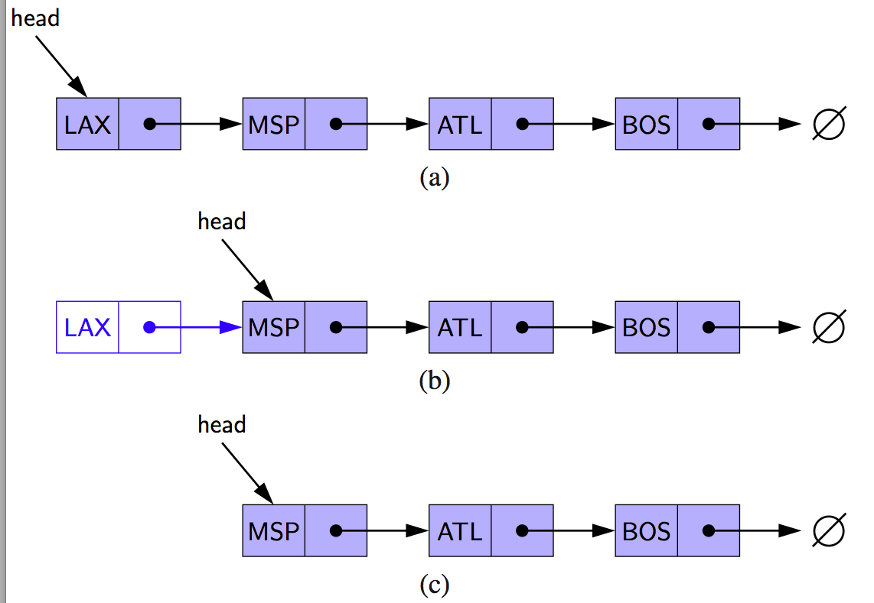
Removing an Element from a Singly Linked List
Removal of an element at the head of a singly linked list:
(a) before the removal;
(b) after “linking out” the old head;
(c) final configuration.

Slide 18
The linked list removal process:
(a) The linked list before removing the node with value 10.
(b) The linked list after removal.
1 marks the list node being removed. it is set to point to the element.
2 marks the next field of the preceding list node, which is set to point to the node following the one being deleted.
Remove Method:
E it = curr.next().element(); // Remember value curr.setNext(curr.next().next()); // Remove from list

Slide 19
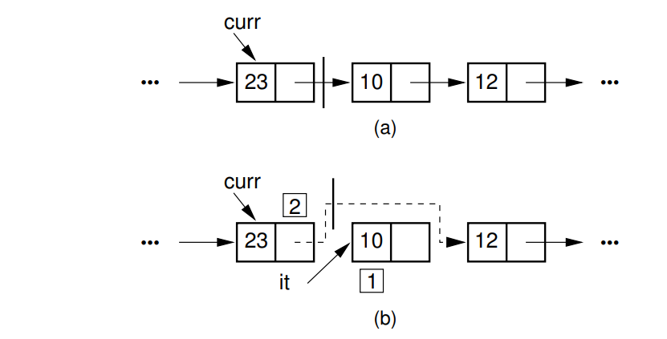
The Linked list removal process.

Slide 20
Algorithm
removeFirst( ):
if head == null then the list is empty. head = head.next {
make head point to next node (or null)}
size = size−1 {decrement the node count}
Removing the node at the beginning of a singly linked list:
Reverse operation of inserting a new element at the head.
Update head to point to next node in the list
Allow garbage collector to reclaim the former first node

Slide 21
Removing at the Tail
Removing at the tail of a singly linked list is not efficient!
There is no constant-time way to update the tail to point to the previous node.
Even if we maintain a tail reference directly to the last node of the list, we must be able to access the node before the last node in order to remove the last node.
But we cannot reach the node before the tail by following next links from the tail.

Slide 22
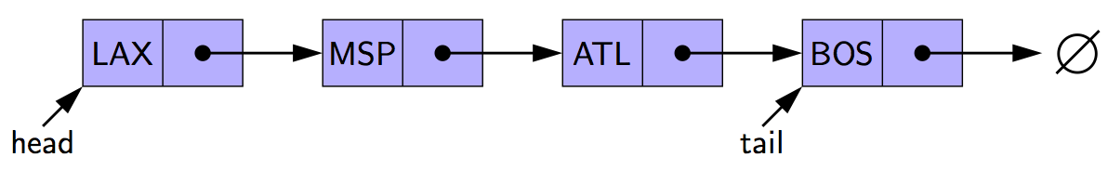
The only way to access this node is to start from the head of the list and search all the way through the list.
But such a sequence of link-hopping operations could take a long time.
If we want to support such an operation efficiently, we will need to make our list doubly linked

